Slide 1
Core MQ Battery Test Code Integration Proposal

Slide 2
Business / Cost Justification
Why?: Battery attributes are needed to perform complete battery warranty analysis. These battery attributes are not stored in Core MQ for historical and new incoming battery claims. Current method employed by factory analysts is the use of Excel VBA macros. But the macros do not store the battery attributes and can only process up to 65,000 rows of data. Therefore, each time a battery report needs to be created or battery warranty analysis needs to be perform, requires several hours to complete. Furthermore, battery analysis is performed locally by factory side analysts only. There is no current method/solution to enable all sites to perform battery analysis.
Goal: Create a Core MQ table that contains the battery test code attributes, claim attributes, and also VIN attributes so that factory and American Honda analysts can create summary reports with ease.
End Goal:
Core MQ
Database
Core MQ
Battery
Analytical
Reports
Core MQ table
containing
battery attributes

Slide 3
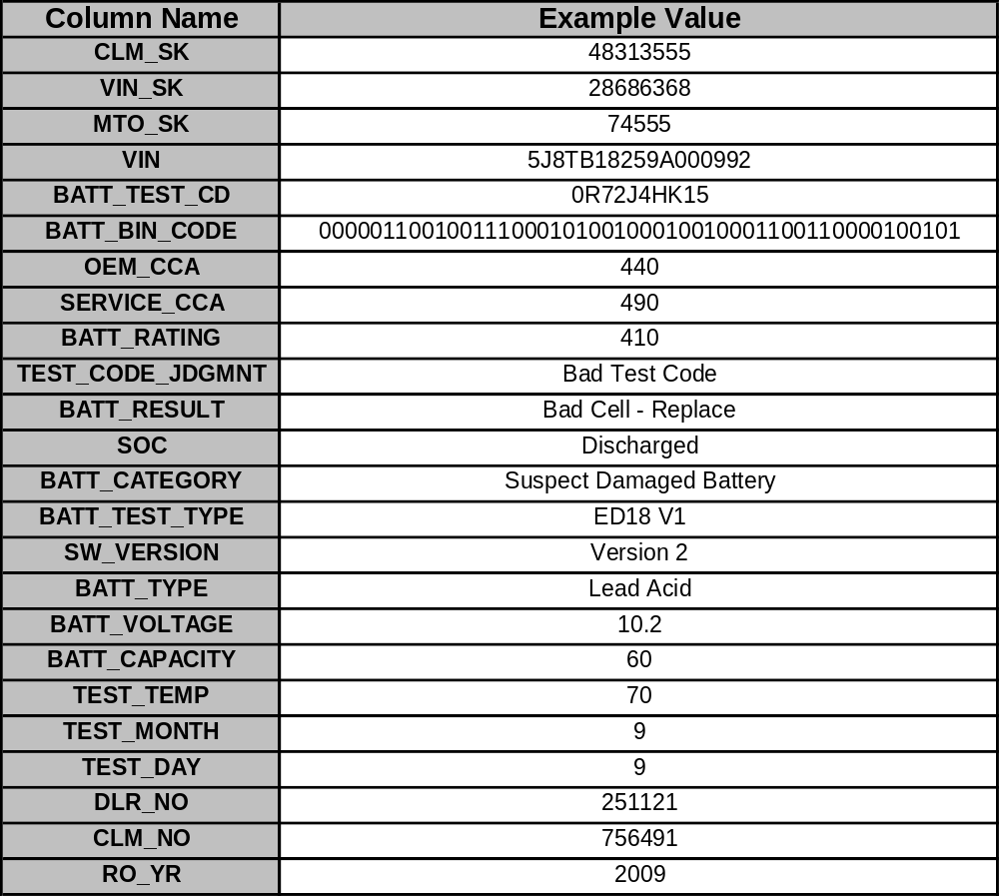
Goal: Create a table within Core MQ so that reports can be made with ease by analysts from ALL sites.
Note: Exact column names and which columns to include are to be decided by the business team.
Example below is just for illustrative purposes:

Slide 4
General Processes Required to Achieve Goal
Two sets of battery attributes need to be created:
Create 10 battery attributes derived directly from the battery test code: measured capacity, battery result, battery rating, battery test type, battery type, battery voltage, test day, test month, test temperature, and tester software version
Create 5 battery attributes derived from established business rules: battery test code judgment, battery state of charge, OEM battery rating, service battery rating, and battery category
Before these battery attributes can be created, the battery test codes in the warranty claim records need to be converted (hex → binary)

Slide 5
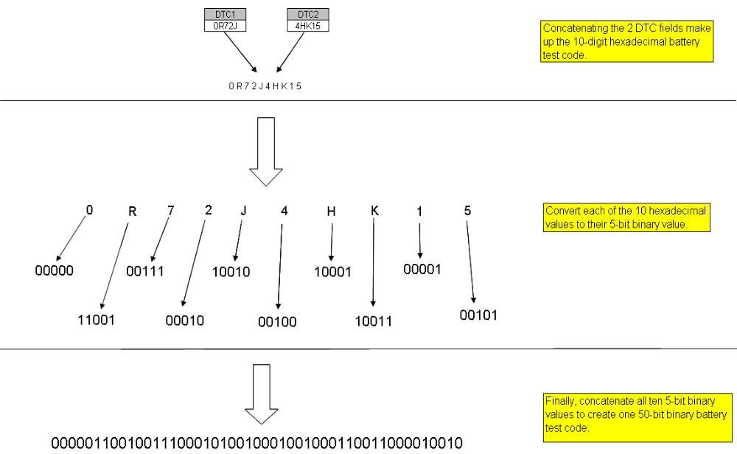
Battery Test Code: Hexadecimal to Binary Conversion Logic

Slide 6
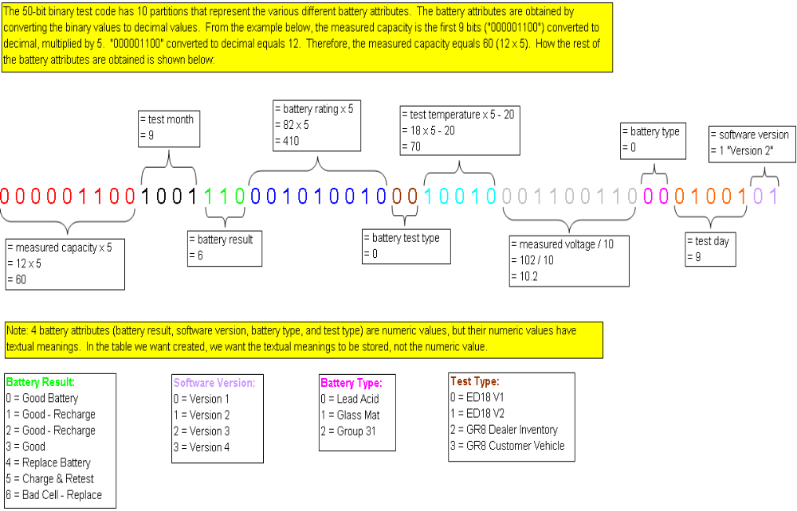
10 Battery Attributes Derived Directly from Battery Test Code

Slide 7
5 Battery Attributes Derived from Business Rules
2 battery attributes (“OEM rating” and “service rating”) are derived based on the model of the vehicle. Specifically, they are dependent on model year, model name, # of engine cylinders, and vehicle destination.
“Battery test code judgment” is derived based on the following business rule:
If battery rating equals to the OEM rating or service rating then
the battery test code is “good”
Else
the battery test code is “no good”
Battery “state of charge” (SOC) is derived based on the following business rule:
If the measured battery voltage is equal to or greater than 12.4 volts then
the SOC equals “charged”
Else
the SOC equals “discharged”

Slide 8
5 Battery Attributes Derived from Business Rules - Continued
Lastly, the most complex and important battery attribute is called the “battery category”. It is derived based on the following business rule below. The business rule is in psuedo-code (If / Else logic) and is dependent on the following battery attributes: battery result, battery SOC, battery test code judgment, battery capacity, and battery rating
if BATT_RESULT == "Bad Cell - Replace":
BATT_CATEGORY = "Suspect Damaged Battery"
elif BATT_RESULT == "Bad Test Code":
BATT_CATEGORY = "Bad Test Code"
elif SOC == "Bad Test Code":
BATT_CATEGORY = "Bad Test Code"
elif SOC == "Discharged" and BATT_RESULT != "Bad Cell - Replace" and TEST_CODE_JDGMNT == "Good Test Code":
BATT_CATEGORY = "Discharged"
elif SOC == "Discharged" and BATT_RESULT != "Bad Cell - Replace" and TEST_CODE_JDGMNT == "Bad Test Code":
BATT_CATEGORY = "Bad Test Code"
elif SOC == "Charged" and BATT_RESULT != "Bad Cell - Replace" and TEST_CODE_JDGMNT == "Bad Test Code":
BATT_CATEGORY = "Bad Test Code"
elif SOC == "Charged" and BATT_RESULT != "Bad Cell - Replace" and TEST_CODE_JDGMNT == "Good Test Code":
if battery capacity < 0.85 * battery rating:
BATT_CATEGORY = "EOL"
else:
BATT_CATEGORY = "NTF“
Therefore, below are the 5 applicable values that the battery category can be assigned to:
“Suspect Damaged Battery”
“Bad Test Code”
“Discharged”
“EOL” (“end of life”)
“NTF” (“no trouble found”)

Slide 9
Conclusion - Business Benefit
With battery attributes available as a Core MQ table, the following business questions can be answered in the form of analytical reports:
How many battery claims failed due to end of life failure (EOL)?
How many battery claims had the wrong battery test codes?
Which model have a higher defect rate for end of life failures?
How much do batteries that failed due to manufacturing defect cost?
Etc, etc…
Goal:
Core MQ
Database
Core MQ
Battery
Analytical
Reports
Core MQ table
containing
battery attributes

Slide 10
END

